Slide 1










STEP ISRAEL CONFERENCE 2023
Best Practice for Israeli Investments into the EU
13-14 JUNE 2023

Slide 2




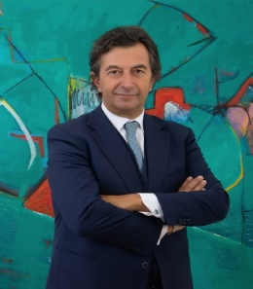

STEP ISRAEL CONFERENCE 2023
Dr. Judith Taic TEP
Dr. Judith Taic Law Office
Israel & Germany
Michel Collet
CMS Bureau Francis Lefebvre
France
Gerd Kostrzewa
Heuking Kühn Lühr Wojtek
Germany
Scott J Bakal
GT Greenberg Traurig
USA
Dr. Luigi Belluzzo TEP
Belluzzo International Partners
Italy
Richard Melton TEP
Vistra (Cyprus) Ltd.
Cyprus

Slide 3
STEP ISRAEL CONFERENCE 2023
Insights into how to invest or relocate to your country

Slide 4


DESTINATION ITALY
The attraction of Italy for individuals and investment
Luigi Belluzzo
Founding Partner, Belluzzo International Partners
STEP Israel Conference June 2023
MILANO Via Andegari, 4 20121 tel. +39 02 365 69657 studio@belluzzo.net | VERONA Vicolo Pietrone, 1B 37121 tel. +39 045 591999 studio@belluzzo.net | LONDRA 38, Craven Street WC2N 5NG ph. +44 (0)20 700 42660 london@belluzzo.net | SINGAPORE 19 Cecil Street, The Quadrant #04-01 -049704 ph. +65 6653 5361 singapore@belluzzo.net | LUGANO Via Nassa, 60 6900 ph. +41 (0)91 252 0780 lugano@belluzzo.ch | ROMA Viale Regina Margherita 294 00198 ph. +49 06 442 51509 studio@belluzzo.net

Slide 5
Italian targets
Israeli investment in Italy, EU
Investor as an individual
Through a company
Through a Trust
Italian IMEX | Investment Management Exemption
Immigration&Relocation
Investor Visa & New Tax Resident Italian Regime for HNWI pensioners and talents

Slide 6










as individual
MAIN DIRECT TAXATION
Individual taxation with progressive rates up to 43%
Substitute taxation on rents 21% under certain conditions (so called ‘cedolare secca’)
Substitute taxation on financial capital gains and dividends 26% in most cases
Capital gains on artworks not taxable if the transferor is a 'collector’. Business income or capital gain depending on the transferor in other cases
Capital gains on residential property are exempt if the transfer occurs more than five years after the purchase
Income derived by a resident of ISR from immovable property situated in Italy (rent income) may be taxed in Italy – Article 6
Dividends paid by a company resident in ITA to a ISR resident will be taxed also in ITA but if the recipient is a beneficial owner the tax shall not exceed 10% (where the BO is a company holding directly 25%+ of the capital) or 15% (in the other cases) – Article 10
Gains: (i) from the alienation of immovable property situated in ITA (or shares in real estate companies) may be taxed in ITA; (ii) derived by a ISR resident from the alienation of ITA shares may be taxed in ITA only if the ISR resident owned at any time within the 24-month period preceding such alienation shares possessing 10%+ of the voting rights; (iii) from the alienation of any property other than that abovementioned shall be taxable only in the State of the resident – Article 13
ITA-ISR DOUBLE TAXATION AGREEMENT
MAIN INDIRECT TAXATION
Local real estate tax (so called “IMU”) is generally levied annually by the municipality where the immovable property is rented (base rate 0.86% of the revaluated cadastral value). In the case of property that is not rented, the amount due under IMU replaces the IRPEF due
Inheritance and Gift taxation among the lowest in Europe: 4, 6, 8% with exemption between 100k and 1 MLN depending on the family relationship between donor/de cuius and done/heir

Slide 7





No EU Passport? → The investor visa → ITALY
The Investor Visa
The Italian Investor Visa provides for a two-year special visa and residence permit for foreign investing in Italian Market (renewable without limits for other three years period).
From 2020 the investor resident permit holder is not subject to a minimum period of stay.
Type of Relevant Investment
Italian listed or unlisted operating companies
(min. € 500k)
Government bond issued by the italian republic
(minimum € 2 Mln)
Philantropic donation
(MIN. € 1 MLN)
Italian INNOVATIVE companies
(min. € 250k)
The «NTR» Italian Flat Tax Regime
According to Italian Tax Consolidated Act, a new tax resident in Italy may elect to be taxed under the new regime whereby all foreign source income, as well as capital gains realised on foreign investments and other asset disposals, are subject to an annual flat tax of EUR 100,000 for up to 15 years.
  Not being tax resident in Italy in the last 9 out of 10 years (including Italian and non-Italian citizen);
  The regime can be extended to one or more family members (paying an annual flat tax of €25 K).
  Favourable regime is applicable for maximum 15 years.
  No remittance issues.
  No requirement to report the assets held abroad in the tax return nor to disclose them in any way to the Tax Authorities
  The “NTR” flat tax is fully covering all income tax related to asset held out of Italy, any wealth tax related to asset held out of Italy, any Inheritance or Gift tax related to asset held out of Italy; ATTENTION to Capital Gain on “qualifying” shares for the first 5 years.

Slide 8


through a Trust
DIRECT TAXES
In the case the Trust qualifies as “opaque” (i.e. a trust where the beneficiary still does not have the right to claim income on assets) the income is subject to Corporate Income Tax at a 24% tax rate. The actual distribution to the resident beneficiaries is not further subject to taxation
Please note that the Trust cannot apply for the substitute regime of ‘Cedolare Secca’
The total income is represented by the sum of the income that is considered taxable in Italy determined according to individual income tax rules → exemption on capital gains on residential property ‘over five years’ will apply
FINAL DISTRIBUTION:
Transfer of income (‘income’ basket) to the resident beneficiary are not taxable to the extent is already taxed upon the Trust
In case the Trust is established in Low-Tax Jurisdiction, income not taxed in Italy and distributed to Italian Beneficiaries are taxable as capital income
See previous slides
‘OPAQUE’
TRUST
ITA-ISR DOUBLE TAXATION AGREEMENT
INDIRECT TAXATION
Local real estate tax (so called “IMU”) is generally levied annually by the municipality where the immovable property is located (base rate 0.86% of the revaluated cadastral value). In the case of property that is not leased, the amount due under IMU replaces the IRPEF due
Transfer of capital (‘capital’ basket) to the beneficiary is subject to Inheritance and Gift Taxes depending on the beneficiary’s relation with the de cuius or donor. Please note that in case of good not situated in Italy and Donor not resident in Italy no gift/inheritance tax is due in Italy even if the beneficiaries are Italian tax resident

Slide 9
through a company
MAIN DIRECT TAXATION
Generally speaking, the mere fact of owning a real estate asset in Italy does not constitute a PE (see Italian Supreme Court n.8815/87 and Ruling no.460196/1989 of Italian Tax Authorities). However, a permanent establishment may arise whether the foreign SPV disposes of an entrepreneurial structure in Italy
If the non-resident company or entity does not have a PE in Italy, the total income is represented by the sum of the income that is considered taxable in Italy determined according to individual income tax rules → exemption on capital gains on residential property ‘over five years’ will apply
In the presence of a PE income is determined on the basis of the profit and loss account of the PE, making the upward or downward adjustments provided for by the corporate income tax rules
Corporate Taxation 24%
Income derived by a resident of ISR from immovable property situated in Italy (rent income) may be taxed in Italy – Article 6
The profit of an enterprise of ISR shall be taxed only in that State unless the enterprise carries on business in ITA through a PE situated therein. – Article 7
Dividends paid by a company resident in ITA to a ISR resident will be taxed also in ITA but if the recipient is a beneficial owner the tax shall not exceed 10% (where the BO is a company holding directly 25%+ of the capital) or 15% (in the other cases) – Article 10
Gains: (i) from the alienation of immovable property situated in ITA (or shares of a company the property of which consists principally of immobile property) may be taxed in ITA (see → domestic Italian exemption on some RE gains; (ii) derived by a ISR resident from the alienation of ITA shares may be taxed in ITA only if the ISR resident owned at any time within the 24-month period preceding such alienation shares possessing 10%+ of the voting rights; (iii) from the alienation of any property other than that abovementioned shall be taxable only in the State of the resident – Article 13
100%
Investments in Italy may alternatively be carried out through a European or non-European (e.g. Israeli) company
NewCo
ITA-ISR DOUBLE TAXATION AGREEMENT
PE
NO
PE

Slide 10

Vistra (Cyprus) Ltd.
STEP Israel 14th June 2023
Presented by:
Richard Melton TEP
Executive Director Vistra (Cyprus) Ltd.

Slide 11

Cyprus Permanent Residency Program (PRP)
€300,000
House/Apartment (new-build), or
Purchase of another form of real estate such as offices, shops, hotels or similar developments, or
Share capital of a Cypriot company with activities and personnel in Cyprus which is based and operates in Cyprus with a proven physical presence and employs at least five (5) people, or
Shares of a Cyprus Investment Organisation for investments carried out in Cyprus.
In addition, the applicant should prove that he has at his disposal a secure annual income emanating from abroad of at least €50,000. The annual income is increased by €15,000 for a dependent spouse and €10,000 for each dependent minor child.
Source: Regulation 6(2) of the Aliens and Immigration Regulations

Slide 12

Cyprus Permanent Residency Program (PRP)
“Fast Track” Residency Application procedure is highly efficient – approx. two (2) months
PRP holders and family members included in the permit may apply for a Schengen Visa through any Schengen European Embassy
Eligibility for Cyprus citizenship by naturalization, currently after 5 years
Eligibility to apply for tax residency in Cyprus and benefit from resident non-domicile regime, and 60 day-tax residency*
No need to reside in Cyprus, though a visit every two years is required
No Greek-language required, or interview
Residence applies to applicant’s spouse, minor and unmarried children up to 25
*The '60-day rule' for Cyprus tax residency is satisfied for individuals who, inter alia, cumulatively, in the relevant tax year: do not reside in any other single state for a period exceeding 183 days in aggregate. are not considered tax resident by any other state

Slide 13

Cyprus Taxation Highlights (Resident Non-Domiciles)
ALL Cypriot tax resident domicile individuals are subject Special Defense Contribution (SDC), on the following types of income:
17% on dividend income
30% (or 3%) on passive interest income
3% on 75% of rental income
However, an individual who has obtained and maintained a domicile of choice outside Cyprus pursuant to the Wills and Succession Law of Cyprus will be exempt from SDC.
A ‘Non-Domiciled’ Tax Resident in Cyprus will therefore be subject to the following taxes:
Type of Income | Income Tax | SDC
Dividends | Exempt | Exempt
Interest | Exempt | Exempt
Rental Income | Taxable (normal rates) | Exempt
Source:
Special Contribution for the Defense of the Republic Law (Law No. 117(I) of 2002 , as amended)
Wills and Succession Law (Cap 195)

Slide 14
FRANCE
Michel Collet

Slide 15

Why should I domicile in France?
Exemption up to 50% of salary and foreign source passive income for 8 years if hired from overseas by a French company (or French branch of a foreign company) subject to conditions.
Exemption of gift tax and inheritance tax on assets received from overseas from foreign donors or decedents for 6 years (to the extent that the individual was not tax resident in France for more than 6 years over that last 10 year period).
Exemption of the wealth tax on foreign real estate for 5 years
Full exemption of capital gains tax (36,2%) on the sale of the dwelling.
No Exit tax on latent gains on shareholdings (French and foreign) not applicable if transfer of domicile from France before 6 years
Dividend and gains on shares taxed at 30/34% (possibly reduced to 27,5% with the benefit of the impatriation regime)
Conclusion : with residence in France for maximum 5 years
  No estate tax / gift tax on foreign assets
  No Wealth tax on foreign real assets
  No exit tax
15

Slide 16

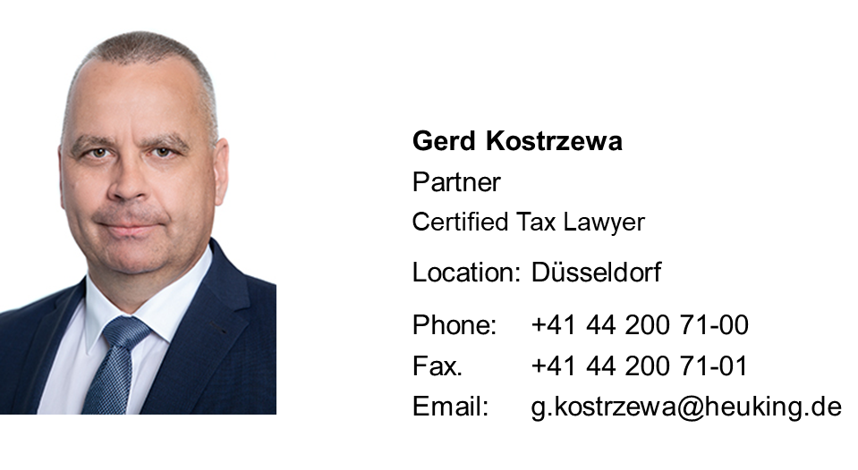
Best Practice for Israeli Investments into the EU – The German Perspective
STEP Israel Conference 13-14 June 2023
Gerd Kostrzewa TEP, Heuking Kühn Lüer Wojtek, Düsseldorf, Germany

Slide 17
The unfriendly German taxation framework
      German living place constitutes German tax residence; no day-count! World-wide income taxation for German tax residents (tax treaty relief may apply, mostly exemption method)
      German tax residents are subject to gift/inheritance tax on worldwide assets they transfer or receive by way of gift or inheritance
      Maximum Inheritance and gift tax rate 30% for spouse, children and grandchildren; 50% for unrelated recipients
      Income taxation of undistributed trust/foundation income; income and/or gift taxation on trust/foundation distributions
      Exit taxation rules (sec. 6 Foreign Transactions Tax Act)
      Maximum income tax rate 47.475 %; corporation income tax rate approx. 30% (including trade tax)
      German corporate income taxation for foreign companies with German center of management
      Extensive information exchange

Slide 18
Believe it or not: We actually have some tax benefits
      No wealth tax
      26.375 % flat tax on capital income from interest, dividends, capital gains from sale of securities or corporate shares (if less than 1 %)
      Total or substantial gift/inheritance tax exemption for business transfers
      Possibility of tax-neutral cross-border corporate restructuring
      No capital gains taxation on sale of art, antiques, gold, jewels vintage cars etc. and crypto assets, if held for more than 1 year or on personally held real estate, if held for more than 10 years

Slide 19
German anti-abuse rules
      We have them all …
      Almost 100,000 tax authority employees; every return is reviewed, frequent field audits, extensive application of tax fraud rules
      General anti-abuse rule (GAAR): Abusive “inappropriate” legal structures are disregarded for tax purposes (sec. 42 Fiscal Code)
      CFC rules: Passive income of corporate entities located in low-tax jurisdictions is taxed at level of German shareholders (sec. 7-13 Foreign Transactions Tax Act)
      National anti-treaty shopping rule: No withholding tax reduction under tax treaties or EU directives for foreign holding companies with insufficient substance (sec. 50d para. 3 ITA)
      National subject-to tax and switch-over rules leading to non-application of tax treaty benefits (sec. 50d para. 8 & 9 ITA)
      Implementation of transparency rules: CRS, FATCA and disclosure of foreign investments, disclosure of cross-border tax arrangements (DAC 6)

Slide 20
German exit taxation rules
      New rules under sec. 6 Foreign Transactions Tax Act (Außensteuergesetz – AStG) as of 2022.
      Exit taxation applies to individuals who leave Germany and directly or indirectly hold or have held within the last 5 years at least 1% of the shares in a German or foreign corporation and were subject to German resident income taxation for at least 7 years within the last 12 years.
      Exit tax arises
          if shareholder gives up German tax residence
          if - in case of a dual German/foreign tax resident shareholder - Germany looses the right to tax a capital gain from a sale of the respective shares due to a shift of the shareholder’s tax-treaty residence under the tie-breaker-rule of the respective tax treaty
          if the shares are transferred to a non-resident new shareholder by gift or inheritance
      Exit tax can no longer be suspended if shareholder relocates within the EU, but can be paid in installments over 7 years
      Step-up is only granted if shareholder was subject to exit tax in former country of residence
      Exit tax is levied at normal progressive rates on 60% of the deemed capital gain; this amounts to approx. 30% tax on the capital gain
      Exit taxation may not apply if shareholder maintains predominant tax treaty residence outside Germany

Slide 21
EU Investments for Dual Israeli-US Taxpayers
Scott J. Bakal
Greenberg Traurig, P.A.
401 E. Las Olas
Suite 2000
Fort Lauderdale, FL 33301
Scott.bakal@gtlaw.com
Tel: 954-768-8228

Slide 22
Overview
1. There are approximately 200,000 Americans living in Israel. These individuals are subject to both the Israel and US tax regimes.
2. Approximately 4000 US citizens make Aliyah to Israel each year, entitling them to the Oleh Chadash rules. A meaningful number of these individuals will not renounce their US citizenship, meaning that they remain subject to both the US and Israeli tax systems.
3. While a number of EU countries provide tax benefits to foreign investors (or foreign persons who are resident but not domiciled in an EU country), the attractiveness of these benefits must be scrutinized when a dual Israeli/US taxpayer can still face exposure in for tax in the United States.

Slide 23
Estate Tax Treaties with EU Countries
1. While the US has a robust network of income tax treaties with approximately 65 countries, the US only has estate tax treaties in place with 16 countries, Australia Finland Ireland, Austria, France, Italy, South Africa, Canada (though the income tax treaty), German, Japan, Switzerland, Denmark, Greece, Netherlands, and the United Kingdom.
2. Estate tax treaties may provide clear cut definitions of domicile, resolve issues of dual domicile, reduce or eliminate double taxation and provide other deductions and other tax relief.
3. Estate tax treaties will not, however, eliminate estate taxation if the other country waives the right to tax assets situated in that other country under such country’s domestic law. That is because the US will still impose estate tax on such assets. Accordingly, US/Israeli dual residents (meaning US citizens residing in Israel or Israeli citizens who are domiciled in the US) will not be able to eliminate US estate taxation of non-US income, even if third country provides complete estate tax relief.

Slide 24
Income Tax Treaties
1. The US has a robust network of income tax treaties with EU countries. When investing in an EU country, a dual US/Israeli taxpayer will want to structure their investments to lower taxation at the source country, so that at a minimum, the tax rate in the source country does not exceed their rate of US income taxation (to the extent possible).
2. For example, a dual US/Israeli taxpayer might want to invest in Germany through an S corporation holding an interest in a limited liability company. Most tax treaties provide a lower rate of dividend withholding on dividends paid to companies than to individuals, possibly on the assumption that the company will have a higher rate of taxation due to the US double taxation of corporate entities. However, in the case of an S corporation or other fiscally transparent entities such as limited liability companies that own an interest in a limited liability company doing business in Germany, the income of the company is taxed at the same effective rate as the income of individuals.
3. Also, the definition of resident should be examined when looking at taking advantage of various income tax treaties. Some treaties define residence at being subject to taxation in the country of residence. But consider an Oleh Chadash in Israel or someone residing in a country who is taking advantage of the resident non domiciliary regime in that country. If such a taxpayer is not subject to tax on their worldwide income, the same as a resident of their country, is such a taxpayer truly subject to tax on a worldwide basis, and thus considered a resident of their home country for income tax treaty purposes?

Slide 25
Section 1202 Planning
1. Because the US taxes its citizens (including Israeli dual citizens) on a worldwide basis, without any need for residence in the US, those tax systems which provide tax holidays for their residents are of little use for US citizens.
2. There are, however, a couple of US tax provisions which completely exempt the income of a US taxpayer from US tax. A US-Israeli dual citizen residing in an EU country which provided a tax holiday could take advantage of these provisions to have their income exempt from tax in the US, Israel, and the EU country!
3. One such often overlooked tax provision is Section 1202 of the Internal Revenue Code.
4. If a US taxpayer invests in a C corporation (i.e., not fiscally transparent), on the date that the stock was acquired, the corporation had $50 million (US) or less in assets, the corporation carries on an active trade or business (but not in accounting, actuarial science, architecture, athletics, banking, brokerage services, consulting, engineering, farming, financing, health, insurance, investing, law, leasing, performing arts, or any business operating a hotel, motel, restaurant, or similar business), and the taxpayer has held his stock for more than five years, gain on the sale of the stock can be exempt from US tax, to the extent that the gain does not exceed 10 times the taxpayer’s investment in the corporation or $10 million.
5. This structure could be used if a US taxpayer holding an interest in a non-US company filed the articles of incorporation in a state such as Delaware, causing the stock to be treated as a US corporation. If the dual US-Israeli citizen residing in an EU company sold his stock, the gain could be exempt from US taxation under Section 1202.
6. If the holding company is going to acquire an interest in an operating business, the operating business could check the box to be fiscally transparent for US tax purposes, so that the holding company qualifies for the active trade or business exception.

Slide 26
STEP ISRAEL CONFERENCE 2023
Why should you open or run a start up in your Jurisdiction?

Slide 27
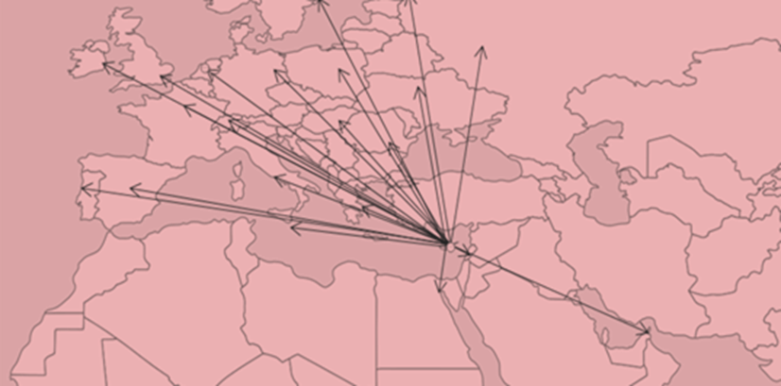
Why Establish a Start-up in Cyprus?
Legal System and Company Law
EU Directives and Double Taxation Conventions
Location and Time Zone (GMT+2)
Foreign Interest Company Regime
Low Corporate Income Tax Rates
Preferential Tax Regime for Software Intangibles
Access to Skilled Local Workforce
Tax Incentives for Businesses, Entrepreneurs & Employees
Low Cost of Services
€280m Government Investment to Upgrade Digital Infrastructure (2022-2030)
Investment and Funding
Fast Track Business Activation
Quality of Life

Slide 28



Foreign Interest Company
Non-EU National
A strategy for attracting businesses and talent to Cyprus enables enterprises to qualify as Foreign Interest Companies thus facilitating the employment of skilled third country nationals via a newly established Business Facilitation Unit (BFU) if they fulfil the following criteria:
Minimum gross monthly salary of €2500
A university degree or diploma or equivalent qualification or credentials confirmation of relevant experience in a corresponding employment position of at least 2 years duration.
Submit Provision of an employment contract of not less than 2 years.
Non-domicile (expatriate) employee taxpayers in Cyprus, who are either EU citizens or third-country nationals, with a salary exceeding the amount of €55K, are eligible for a 50% income tax exemption period for 17 years
€200,000
Cyprus Company or Branch
Suitable premises, separate from any private housing or other office, except in case of business co-habitation
Work permits for third country nationals

Slide 29

Cyprus Taxation Highlights (Corporate)
12.5% Corporate Tax on Trading Profits*
0% Tax on Dividend Income
No Taxation on Capital Gains (other than on the sale of immovable property situated in Cyprus)
No WHT on Outward Payments of Dividends, Interest or Royalties
Notional Interest Deduction Regime for Interest Income
IP Box Regime (in accordance with BEPS Action 5) for Qualifying Intangibles
Exit Taxes introduced pursuant to the Anti-Tax Avoidance Directive (ATAD II)
*Certain multinational and domestic group arrangements with combined annual turnover of €750m subject to implementation of EU Pillar 2 Directive and minimum tax rate of 15%.

Slide 30

Why invest in France or setup a startup? (N°2/4mn)
France is the world’s fifth largest economy, the second biggest consumer market in Europe and the world’s seventh largest foreign investor.
  Most attractive country within the EU for foreign investment
    “Foreign direct investment in Europe stalls amidst economic uncertainty, France remains top destination for investors”EY attractiveness survey, 11 may 2023
    Central location in the EU, investment in infrastructure, highly qualified and productive human resources, promotion of startup and digital businesses.
Generous tax credit up 30% of the R&D expenses or 5% (for companies with gross revenue > € 100,000)
  Credit to CIT and cash refund after 3 years
  Immediate cash payment for new companies and new innovating companies
CIT at 25% and 15% for patent licensing.
  Exemption of CIT for new companies and new innovating companies
Tax consolidation and holding regime (1,3% on dividends and 3,8% on sale’s gain of substantial shareholdings (> 5%, 2 year holding)
No CGT for non-residents on the disposal of French issued shares to the extent that the interest is < 25% of the capital.
Friendly tax environment for assigned employees from abroad or new hired employees from overseas (income tax reduced up to 50% on salaries and foreign source income for 8 years).
Subsidies and assistance from national and local authorities
30

Slide 31
Should you run your start-up from Germany?
      No special German tax benefits for start-up companies
      German resident founder may constitute German taxable presence of foreign start-up company
      Transfer of IP from German resident founder to foreign start-up company against shares will be subject to German income tax at level of founder
      Shares granted as compensation for founder’s work for start-up company are subject to German taxation
      Stock options will be subject to German taxation at level of founder (or employee) upon exercise of option
      Minority shareholder founder working as an employee for German or foreign start-up company will become subject to German social security contributions
      Relocation from Germany may expose former German resident founder to German exit taxation

Slide 32
THE INVESTMENT MANAGEMENT EXEMPTION (“IMEX”)
The Italian budget law 2023 (“Budget Law”) has introduced the so-called ‘Investment Management Exemption’ (IMEX) in order to give certainty to Investment Fund Management practices, with a particular focus to the risk for a permanent establishment in Italy (“PE”) for a non-Italian resident fund or its investors.
The new Budget law amends Article 162 of the Italian Consolidated Tax Code (“ICTC”), dedicated to PE, and provides the conditions under which investment funds/investors can avoid being considered as having a PE in Italy due to the activities carried out by managers.
These presumptions are specifically conditioned to:
the residency of the investment vehicle and its foreign subsidiaries in a jurisdiction that allows the exchange of information
the independence requirements of the investment vehicle to be specified in further decrees
the manager requirements in relation to the investment vehicle:
  absence of positions in the management and/or control bodies of the investment vehicle
  absence of a participation of more than 25% in the profits of the investment vehicle
  a fair market value remuneration.
Foreign Asset/Investment manager
Investment
Vehicle
Subsidiary
Italian
Targets
Italian Asset/Investment manager
Italian Office
EXAMPLE 1
EXAMPLE 2

Slide 33
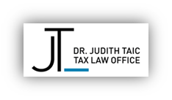
STEP ISRAEL CONFERENCE 2023
Real Estate Investments
How should you structure such an investment?

Slide 34
How to hold German real estate ?
      Direct investment by individual owner
        Income from German real estate is always subject to German taxation (income tax and potentially trade tax)
        Privately held real estate can be sold free of capital gains taxation after a 10-year holding period, if it is held either directly by the individual owner or via a non-commercial partnership (heirs/donees “inherit” their predecessors holding-period)
        Capital gains from the sale of real estate by commercial real estate investors are always subject to taxation
        The transfer of German real estate held directly by non-resident owners or via a partnership is always subject to German inheritance/gift tax

Slide 35
How to hold German real estate ?
      Investment via foreign holding company
        Rental income from of the foreign holding company is subject to 15% corporation income tax
        Capital gain from sale of real estate is always subject to corporation income tax
        Additional trade tax on rental income or capital gains (approx. 15%) can be avoided:
          No trade tax on rental income if owner exclusively generates rental income – Beware: certain facility management services may lead to “other” income and lead to a loss of the trade tax exemption
          Capital gain from sale of real estate is only exempted from trade tax if owner generates rental income during the entire calendar year (sale of last real estate as of 31st December)
          25% of interest expenses for financing of real estate are subject to trade tax if higher than EURO 200,000 per year
        If former and new shareholders are not resident in Germany and if the holding company has sufficient substance, no German inheritance/gift tax would become due on transfer by way of gift or inheritance (structuring via US LLC or Israeli Family Company possible)
        Caution: Direct or indirect transfer of more than 90% of the shares in the real estate holding company leads to German real estate transfer tax at rates of up to 6.5% of real estate value (exception: transfer by gift or inheritance)

Slide 36
Property Classifications
1. The internal laws of an EU country can produce surprising results for dual US/Israeli taxpayers.
2. Consider a Nießbrauch in Germany. This is equivalent to a life estate in the United states or a usufructory in other countries.
3. Property held in a Nießbrauch is exempt from German estate tax at death if the property is held for at least 10 years.
4. However, for a dual US/Israeli taxpayer, this asset will be deemed to be held in a trust, which can create conflicting tax results. For example, if parent establishes the Nießbrauch by retaining a life interest in the property, with the remainder interest to be held by his or her children, for US tax purposes, estate tax will be due on the parent’s death and the taxpayer will obtain a step-up. However, for German purposes, no estate tax will be due and there will be no step-up in cost basis. As a result, the US estate tax paid will not be creditable against any German estate tax liability (because there is none) and there will be substantial income tax due for German purposes going forward, in excess of US tax, because there is a basis step-up for US purposes but not for German tax purposes.

Slide 37
Inheritance by Operation of Law, without an Executor being appointed
1. In some EU countries, property is inherited by operation of law, without an executor being appointed. For example, Poland and Germany.
2. A dual US/Israeli taxpayer will be required to file an IRS Form 3520 upon inheriting assets worth more than $100,000.
3. Generally, the form must be filed for the tax year for which the assets are received.
4. If the assets are legally inherited in a given year but not transferred to the following year, there is a risk that the form (with its associated penalties) will be due at an earlier date than expected. A taxpayer required to file Form 3520 could face a penalty of 35 percent of the value of the inheritance because they thought that there had been no transfer of the asset, determined by applying US tax principles.
The same tax issues could apply to reporting ownership of an interest in a foreign corporation.

Slide 38
Forced Heirship
1. Dual US/Israeli taxpayers are not generally subject to forced heirship regimes, though in the US, we do allow spouses to benefit from election against a will and Israel has multiple community property regimes that may apply depending on year of marriage.
Dual US/Israeli taxpayers may need to elect out of regimes in EU countries that have forced heirship regimes, by specifying choice of law in their will, in accordance with Brussels IV. Etc.

Slide 39

Why should I acquire a French Villa or Chalet?
The acquisition structure depends on the existing structure of the wealth of the client and the project.
  For personal use
    The simplest : direct or through a partnership acquisition (with or without a deb)
      Wealth tax (net value > 1,300,000; Estate tax/gift tax (debt deductible); no income tax (for use).
  For rental : Corporate structure (one in France proves more convenient
      Taxation at 25% (corporate income tax) with deduction of debt’s interest, depreciation, cost of operating;
      Is rental also includes service like services (cleaning, breakfast, reception mainly), the activity would be considered a commercial and as such
        Exemption of IFI and possibly to Estate/gift tax
        VAT recovery on renovation (10% / 20%).
      Mix use (personal/rental)
        No rent-free use by UBO otherwise, the FTA may claim CIT (25%) on deemed rental income (3-5% of the FMV of the property) and distribution tax.
Acquisition from Trusts call for interposed entities (corporate / partnership).
    IFI on settlor ; equivalent of estate tax on passing of Settlor
    Filing obligations.
Tax rates
  On acquisition : Transfer tax + notary fee (7% of the sale price)
  On ownership : IFI (from 0,5% to 1,25% as from € 10,000,000)
  On sale : CGT at 25% (corporate structure); 36,2% (+ additional tax depending the amount of the gain) for individual
  On passing : Estate tax (from 20% to 45% as from € 1,805,677)
39

Slide 40
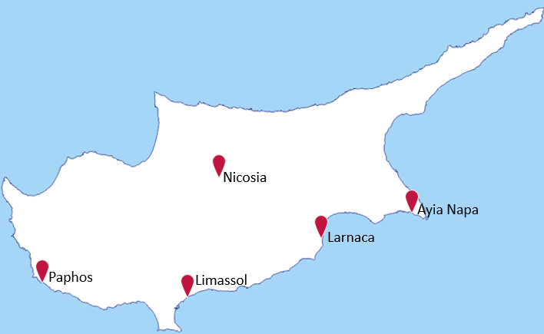
Cyprus Real Estate Sector
In Q1 2023, rental values increased 19.0% for apartments, 12.2% for houses and 3.3% for retail compared to Q1 2022²
More than 1,000 foreign companies relocated to Cyprus in 2022
New office space development slowly increasing following fall during the pandemic. Now being buoyed by increased foreign demand
Total transactions in 2022 reached €5.2bn¹
Limassol and Paphos the most popular with foreigners
Whilst there remains a high-demand for luxury residential properties (>€1.5m), apartments are driving the market with €2.1bn transactions recorded in 2022¹
84% of new developments licensed were residential¹
Demographic changes through high-tech companies, headquartering and Ukrainian refugees fleeing Russia’s invasion have buoyed the market
Across Cyprus year-on-year prices increased in 2023 by 12.3% for apartments, 3.2% for houses, and 2.4% for offices²
Sources:
¹ PWC Cyprus
² Ask Wire Cyprus

Slide 41
Acquisition of Immovable Property in Cyprus
EU/EAA citizens can acquire immovable property in Cyprus without restriction
Acquisition of immovable property in Cyprus by ‘aliens’ is subject to the approval of the Cyprus Council of Ministers
‘Alien’ means any person who is not a citizen of the Republic of Cyprus, and includes an alien controlled company, a company registered abroad and a trust for the benefit of aliens*
Capital gains tax (20%) is imposed on gains from the disposal of immovable property situated in Cyprus including gains from the disposal of shares in companies which own immovable property in Cyprus.
The acquisition or construction of property to be used as the primary and permanent residence is subject to the reduced rate of 5%.
Annual Immovable Property Tax was abolished in 2016
*Immovable Property Acquisition (Aliens) Law Cap 109

Slide 42
Cyprus Economy (Other Key Sectors)
Tourism
ICT
Energy
Finance
Shipping
STAGE 1
Between January – March 2023 arrivals of tourists totaled 393,839, an increase of 61% on the same period in the previous year.
Arrivals from the United Kingdom were the main source of tourism for March 2023, with a share of 33.8% of total arrivals, or 62,282 tourists, followed by Israel with 12.4% or 22,813
€3bn contribution to economy in 2022*
10% of Cyprus GDP*
400 technology firms (25,000 employees)*
€280m government digitalization investment program
Preferential regime for software intangibles
Start-up incentives & Foreign Interest Company Regime
Over 13% of Cyprus’ energy consumption sourced from renewables. The target for 2030 is 23%; however, this could be as high as 40%.*
LNG Storage hub – possible pipeline with Israel
Five large gas deposits have been discovered off Cyprus’s southern coastline (Israel has eleven)
Cyprus remains a quality-efficient and cost competitive hub for regional and global financial services.
Fintech and digital finance are fast developing in thriving segments of the finance sector. Corporate, fund and trust administration services remain strong.
CySEC is currently monitoring 837 companies, which translates to an increase of 3.9% compared to 806 at the end of 2021*
Cyprus has the third largest merchant fleet in Europe and is the EU’s third largest ship management center.
There are more than 200 shipping-related companies in Cyprus today.
.
Text to go here
Source: Statistical Service (Cystat)
*Source: Invest Cyprus
*Source: Eurostat
*Source: Cyprus Securities and Exchange Commission (CySEC)

Slide 43
ITALIAN TARGETS:
BUSINESS, RE & PLEASURE ASSETS
INVESTMENT IN ITALY
Business
  Investing in Italian businesses can be particularly profitable for foreign following the best practices required to structure the investment. Share deal or asset deal, leveraged or equity investments, long-standing or start-up companies, the possibility of locating an asset manager in Italy without the risk of a permanent establishment challenge where the investment management exemption can be applied. These are some of the assessments to be made when investing in Italy.
  The ongoing tax reform 2023-2025 should lead to a particularly favourable environment for those investing in Italian companies by reducing the tax wedge for companies making new investments. It is also expected that the M&A tax neutrality regime will be extended, favouring new forms of aggregation and investment (or disinvestment).
Real Estate & pleasure assets:
  The real estate & pleasure assets market in the Bel Paese has always generated great interest from foreign investors. There are many advantages: inter alia, the possibility of selling residential property without realising taxable capital gains, the possibility of applying an advantageous substitute taxation on rents (so-called 'cedolare secca') as well as the possibility of structuring investments through flexible instruments such as Trusts in a context of legal certainty.
  Moreover, with the tax reform 2023-2025 currently being implemented, a clear regime will be defined for collectors wishing to invest in art works, as well as an extension of the 'cedolare secca' to non-residential properties.
OUR FIRM HAS ALWAYS ASSISTED INVESTORS IN PLANNING THE BEST STRATEGIES FOR AN EFFICIENT INVESTMENT IN FULL COMPLIANCE, PROVIDING:
Assistance for the tax obligations and compliance
Accounting and administrative assistance
Advice on immigration and relocation issues for managers
Advice on the legal framework of the investment
M&A Structuring and Transaction Services
Trust & Estate Planning
HNWI Immigration & relocation

Slide 44
STEP ISRAEL CONFERENCE 2023
New Development in your
jurisdiction for making Aliya to
Israel?

Slide 45

Aliyah and the benefit of the tax treaty
The OCDE type tax treaty (“DTT”) between Israel and France exclude from the tax treaty protection, “persons who is liable to tax in the State of residence] in respect only of income from sources in that State or capital therein” (article 4)
  At stake : less comfort for securing the tax residence in Israel from a French tax perspective where for instance, the individual keeps in France, her/his center of economic interest.
  No taxation in France of French source pensions; no reduced withholding tax rates on French source dividends (5%), royalties (10%-0%)
With no taxation on the foreign source income, persons benefitting from the 10-year exemption were exposed to discussions with source countries and departure State to the challenge of the tax treaty protection.
  Exemption is not a deferral (UK non-domiciled resident regime)
New case law (Toulouse Appeal Court, October 13, 2022, n° 20TL22832 ) determined that French sourced pension may be exempt in France according to the DTT for individuals having moved to Israel in benefitting from the Aliyah since
  Tax residence for the DTT should be determined “by reason of his domicile, residence, or any other criterion of a similar nature, or comparable personal link according to the DTT
      “Taxation of Israeli income by reason of a personal link with the State”
      The extent of the tax obligation should not be relevant
Decision of the Conseil d’Etat (highest court) is expected.
45

Slide 46
STEP ISRAEL CONFERENCE 2023
Takeaways

Slide 47
Thank you
Dr. Judith Taic TEP
drjtaic@law-intax.com
Michel Collet Michel.collet@cms-fl.com
Gerd Kostrzewa
g.Kostrzewa@heuking.de
Scott J Bakal
Scott.Bakal@gtlaw.com
Dr. Luigi Belluzzo TEP
Luigi.Belluzzo@belluzzo.net
Richard Melton TEP
richard.melton@vistra.com

