Slide 1
Tax Residence Individuals moving into and out of Germany Israel & New York Bar Association International Section, Seminar September 19, Tel Aviv
Dr. Judith Taic
LLM Taxation (NYU), TEP
Rechtsanwältin – Germany
Attorney at Law - New York
Advocate – Tel Aviv
drjtaic@law-intax.com

Slide 2
Tax Residence in Germany
Home Habitually Abode
This residence does not need to be the centre of vital interests
Tax Treaties – Tie breaker provision
Centre of vital interests
Habitually stay
Nationality
A (secondary) home (sleeping lot) available under circumstances which justify the assumption that the home will be maintained and used at least occasionally
> 180 days
Even without (secondary) home

Slide 3
Checklist for individuals moving into Germany
Income taxes:
No income tax holidays in Germany available! From the first day you pay.
Avoid coming with a trust in your to Germany (there are pitfalls for trustees and beneficiaries waiting!).
Foreign bank deposit and foreign currency accounts are taxed as foreign assets and trigger substantial reporting.
Consider a pre-emigration income tax planning (stepping up of assets; avoid any trust position; do a German CFC rule check for your entities/maybe use blocker structure; income shall be deferred after the time the client has left Germany.
Inheritance and gift taxes:
The system applies the first day within Germany on your worldwide estate!
Germany has only few Double Tax Treaties for inheritance tax purposes (Denmark, France, Greece, Sweden, Switzerland and the United States(
Consider a pre-immigration succession planning.

Slide 4
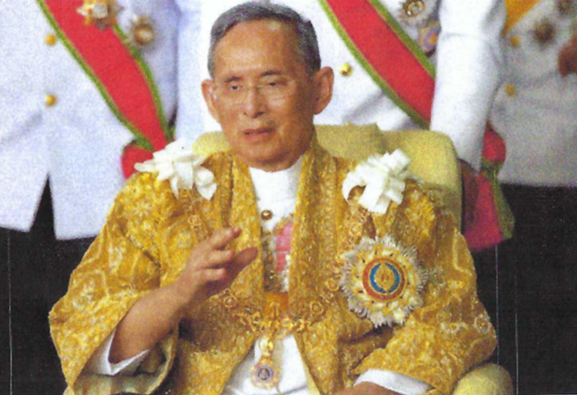
German inheritance and Gift Taxation
German Inheritance Tax
German tax residence of deceased
German tax on worldwide estate
German tax residence of beneficiary
German tax on beneficiary’s interest in worldwide estate
German situs property
German tax on German situs property
King
No German tax residence
No German situs property
German (secondary) home at lake Starnberg, Munich
Double Tax Treaty for income tax purposes between Thailand and Germany: Tie breaker rule: Center of vital interests: Thailand
Double Tax Treaty for inheritance tax purposes between Thailand and Germany: not existent
Result: German right to tax beneficiary’s interest in worldwide estate: 30 % of ca. 40 billions USD

Slide 5
Tax areas of concern for individuals moving out of Germany
Income taxes:
Exit Tax when you stay too long in Germany (7 out of 10 years) (New Rules since January 2022!).
Ten-year tax shadow in case a German Citizen moves to a low tax jurisdiction (Extended German limited tax liability - para 2 Foreign Tax Act (e.g. move to UK, Italy and Switzerland).
Inheritance and gift taxes:
If you became German citizen, for the first 5 years after leaving Germany you are still exposed to the German inheritance and gift tax system with your worldwide estate.

Slide 6
What to take away
Be careful not to establish unintended tax residency
Secondary home suffices if available at any time and used occasionally.
No minimum number of days of presence in Germany required (but > 180 days suffice even without secondary home.
German inheritance tax if either the deceased or beneficiary are German tax resident.
Extended unlimited inheritance/gift taxation for 5 years after leaving Germany if person is German citizen.
Foreign individuals holding assets in Germany
Inheritance/gift taxation on German situs property (e.g. German real estate, partnership interest, at least 10 % holding in German corporation) you may interpose foreign holding entities.
A vacation home in Germany can trigger worldwide inheritance taxation!

Slide 7
Thank You
drjtaic@law-intax.com
www.law-intax.com

