Slide 1
Common Law Trusts and Prenuptial Agreements as Asset Protection- A German View
Dr. Judith Taic
LLM Taxation (NYU), TEP
Rechtsanwältin – Germany
Attorney at Law - New York
Advocate – Tel Aviv
drjtaic@law-intax.com

Slide 2
Common Law Trusts from a German Perspective
Pre/postnuptial Agreements from a German Perspective
Conclusion

Slide 3
Common Law Trusts from a German Perspective
Common Law trusts under the German Law
Transfer of assets located in Germany

Slide 4
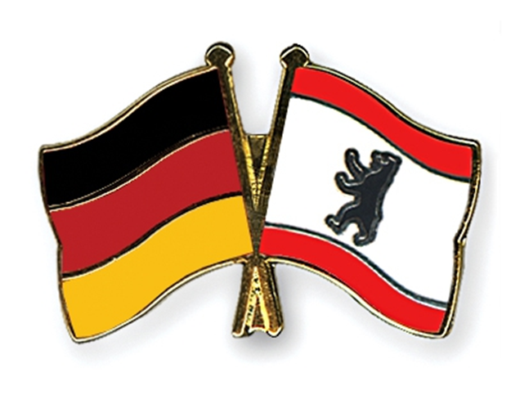
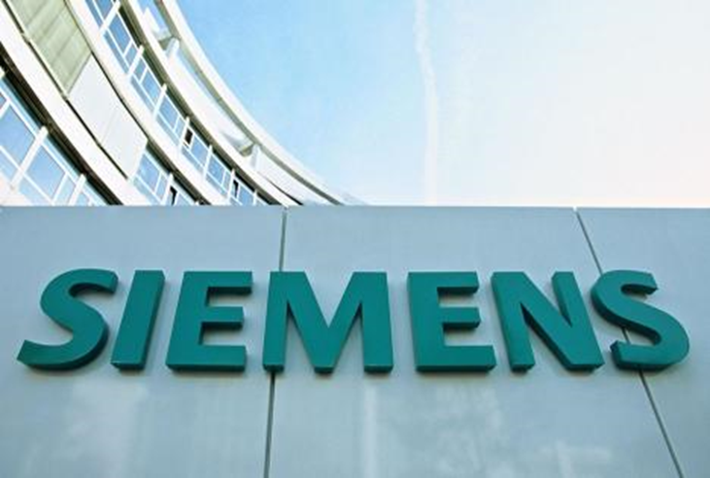
Common Law Trust
Foreign Corporation
Interest in a German partnership
German Real Estate
Shares in a German corporation

Slide 5
Common Law Trusts as asset protection
Statutory matrimonial property regime
Community of accrued gains (“Zugewinngemeinschaft”)
Equalization claim for accrued gains
10 year rule to determine value of final assets

Slide 6
 | Wife | Husband
Final assets at time of divorce | 1,000,000 € | 600,000 €
Initial assets at time of marriage | 100,000 € | 0
Difference between the assets Accrued gains | 900,000 € | 600,000 €
To be paid to husband: 150,000 €

Slide 7
Common Law Trusts as asset protection
claims against third party/trustee
Prove of intention to reduce future equalization claim
Enforceability of German Court decision in offshore jurisdiction

Slide 8
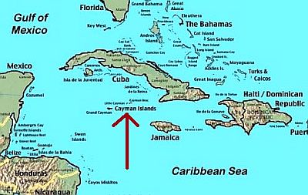
Firewall Legislation of the Cayman Islands
All questions arising in regard to a trust….are to be determined by Cayman Island laws...(Sec.90 Trust Law)
No trust governed by the laws of the Cayman Islands …is void, voidable, …by interest conferred by foreign law upon any person of a personal relationship with the settlor (Sec. 91, Trust Law)
...any foreign judgement inconsistent with Sec. 91 ..., will not be recognized, enforced…in the Cayman Islands (Sec. 93 Trust Law).

Slide 9
Common Law Trusts from a German Perspective
Summary:
Common Law Trusts rather safe tool for asset protection under German Law, if transfer to the trust at least 10 years before the divorce or with the agreement of the other spouse.

Slide 10
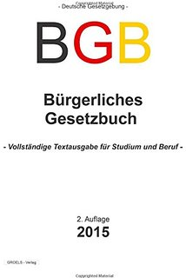
Pre/postnuptial Agreements from a German Perspective
German Civil Code ( ) expressly allows pre/postnuptial agreements

Slide 11
Pre/postnuptial Agreements from a German Perspective
Purpose of pre/postnuptial agreements

Slide 12
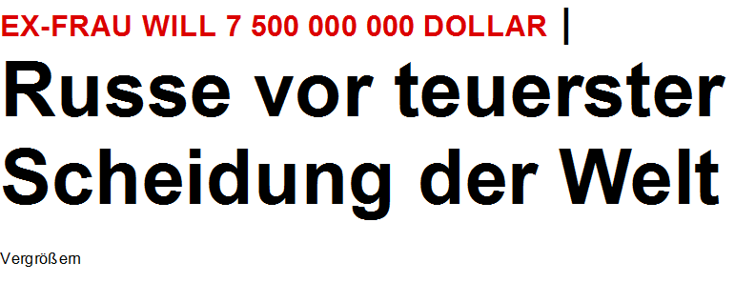
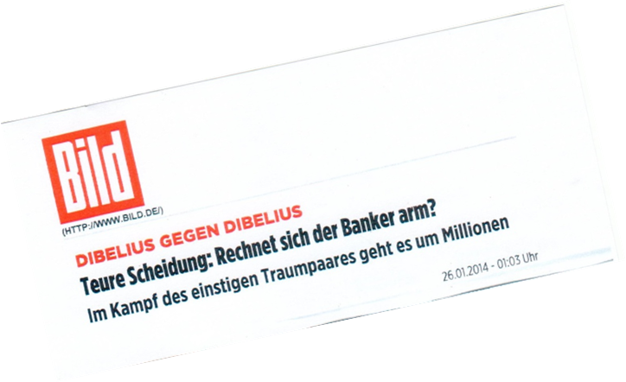
Pre/postnuptial Agreements from a German Perspective
To avoid…

Slide 13
Alexander and Andreas Dibelious : Wife claims 70 million Euro in accrued gains No Prenuptial...

Slide 14
Becker-Trennung: Barbara verklagt Boris
„Nach der Trennung... Verklagt sie ihren Mann vor einem Gericht in Florida auf Unterhalt“

Slide 15
Pre/postnuptial Agreement from a German Perspective
Formal requirement under German Law
Notarization
No requirement for separate legal counsel
No requirement of full disclosure
Problem in an international context
Anglo-American legal systems do not have and do not recognize the Latin system of a civil law notary
Risk of invalidity because independent legal counsel or sufficient disclosure is missing

Slide 16
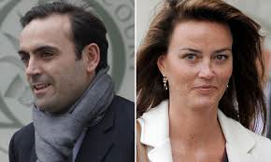
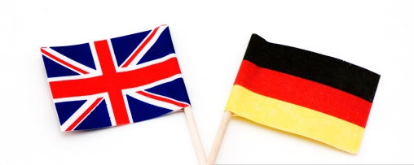
Pre/postnuptial Agreement from a German Perspective
English divorce courts: Nicolas Granatino challenged the agreement with hereiss Katrin Radmacher.
“I did not know how rich Mrs Radmacher really was”

Slide 17
Pre/postnuptial Agreement from a German Perspective
Content and validity of prenuptial agreements
Freedom of contract
Standard of “bono mores”
Standard of “good faith”

Slide 18
Pre/postnuptial Agreement from a German Perspective
Two significant dates have to be differentiated
The time of the conclusion of the contract
The time of divorce and separation

Slide 19
Pre/postnuptial Agreement from a German Perspective
Ordre Public and good faith to core subjects:
Post marital maintenance
Matrimonial property regime
Equalization of pension rights

Slide 20
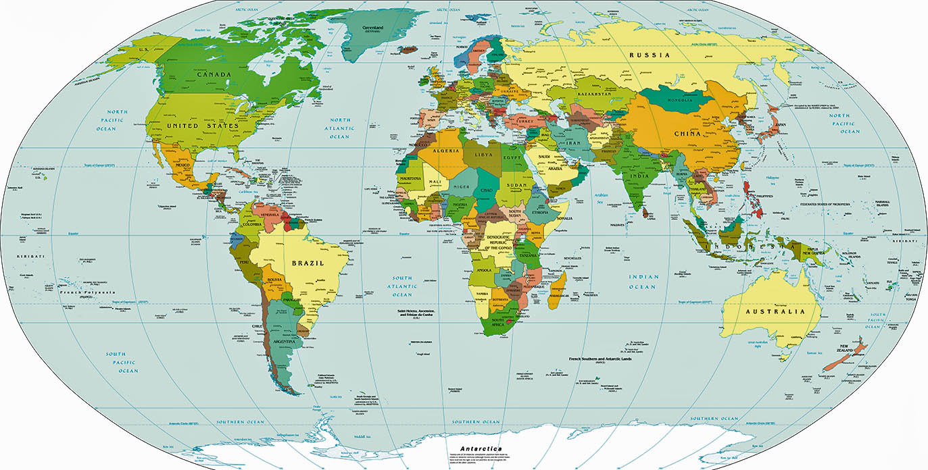
Pre/postnuptial Agreement from a German Perspective
Summary:
Need to develop and agree to a common standard for prenuptial agreements in order to keep pace with the rise of cross border international mobile family relationships.

Slide 21
Pre/postnuptial Agreement from a German Perspective
Summary:
Need for unified rules with respect to the question which country has jurisdiction in order to avoid…..

Slide 22
Conclusion
Common Law Trusts - safe asset protection tools, especially if the assets to the trust are transferred more than 10 years before the divorce or the parties have a prenuptial in place with the complete separation of assets.
The conclusion of a prenuptial agreement is an increasingly popular way to manage the assets in a divorce. Compared to other jurisdictions German courts would more strictly enforce prenuptial agreements.
There is a practical need for a worldwide useable template for a prenuptial agreement which is globally recognized and enforceable.

Slide 23
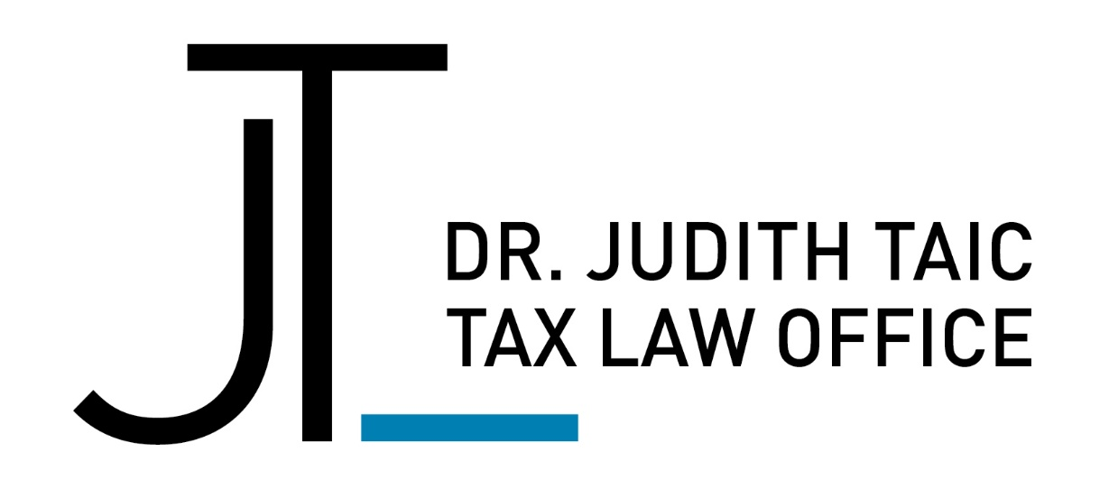
Thank You
drjtaic@law-intax.com
www.law-intax.com

